Slide 1
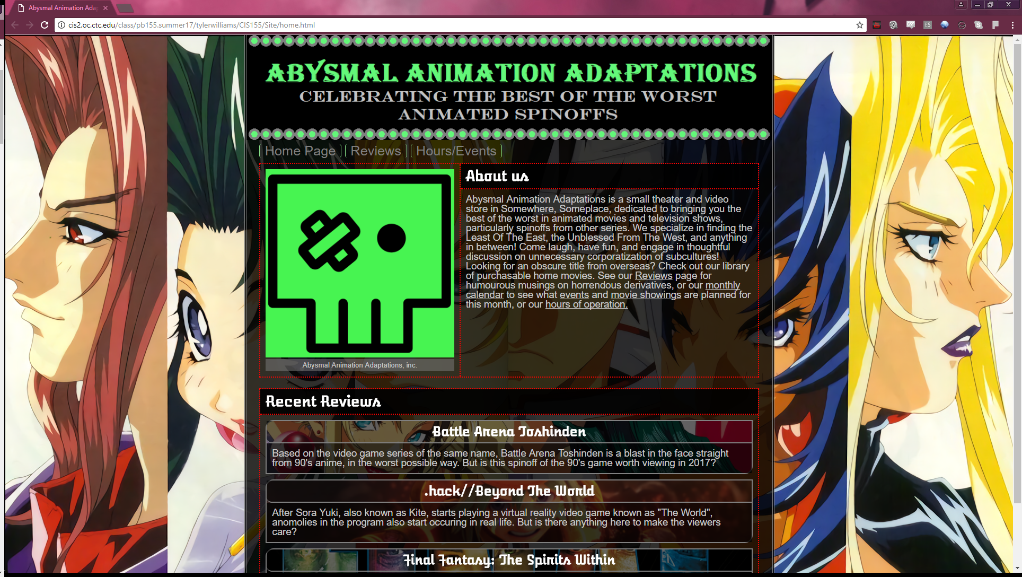

Slide 2

Design Thoughts and Goals
A site for reviewing crappy animated spinoffs.
Site design would be fun, and look like a product designed in the 90’s, and with just a little bit of edge on everything.
Designed with high contrast colors for easier viewing.
Mobile screen size compatibility.
All webpages built on the same basic framework, and all new content goes into the Main element.

Slide 3
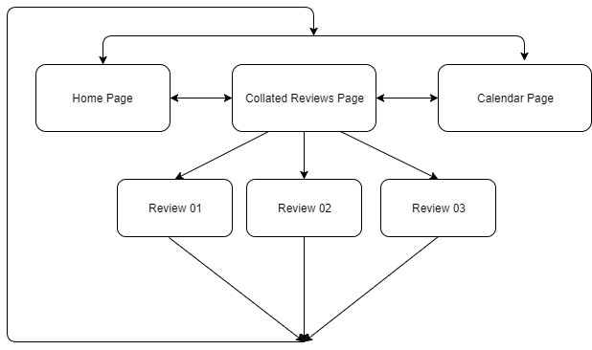
Site Flow and Content
Nested design
Home page, Collated Reviews, and Calendar accessible from all pages.
All Reviews accessible from Collated Reviews page, but not typically accessible elsewise.

Slide 4
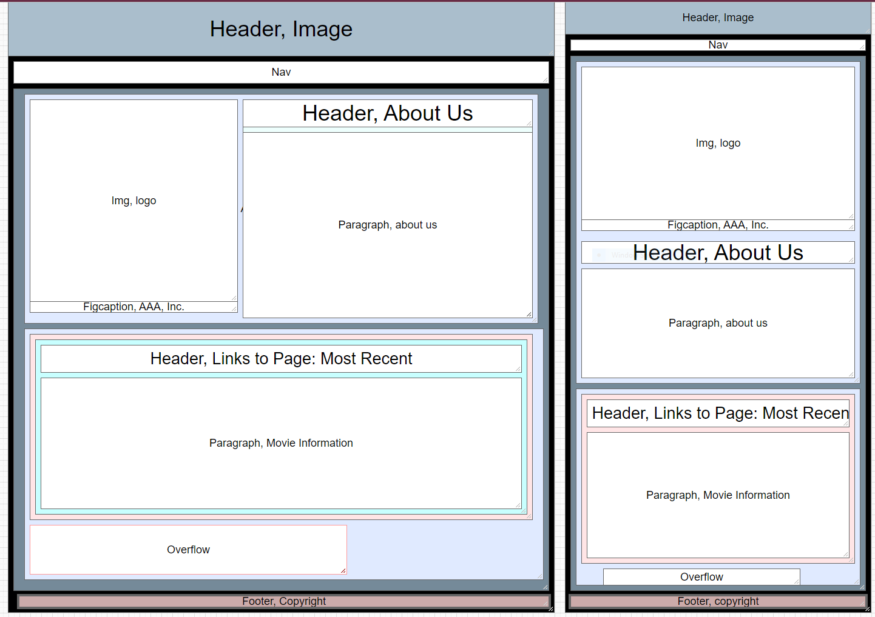
WIREFrame GAME: Homepage
Homepage acts as design anchor for all other webpages.
Multicolumn design for elements with images.
Multicolumn elements collapse in smaller viewports.
“Recent” reviews accessible via overflow box.

Slide 5
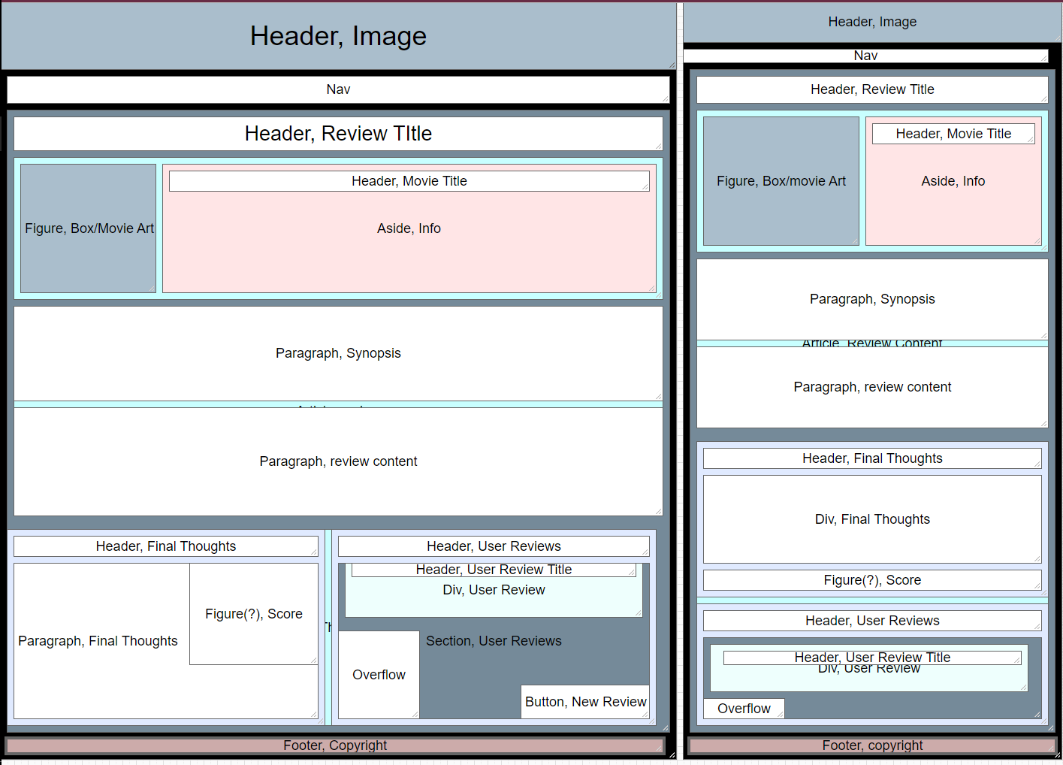
Wireframe Game – The Second: Reviews Page
Top part of Main element gives information on the reviewed video, such as release date.
Last section has final thoughts, score, and user reviews.
Button opens up a user review submission form.

Slide 6
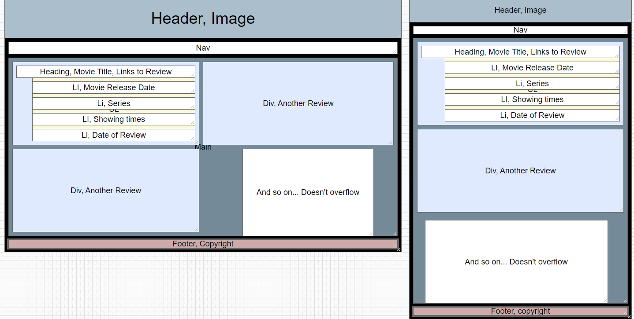
Moar Wireframes: Collated Reviews
Sections with information on the reviewed movie
Headings link to review
2 column design in desktop mode.
Collapses to one column in mobile mode.

Slide 7
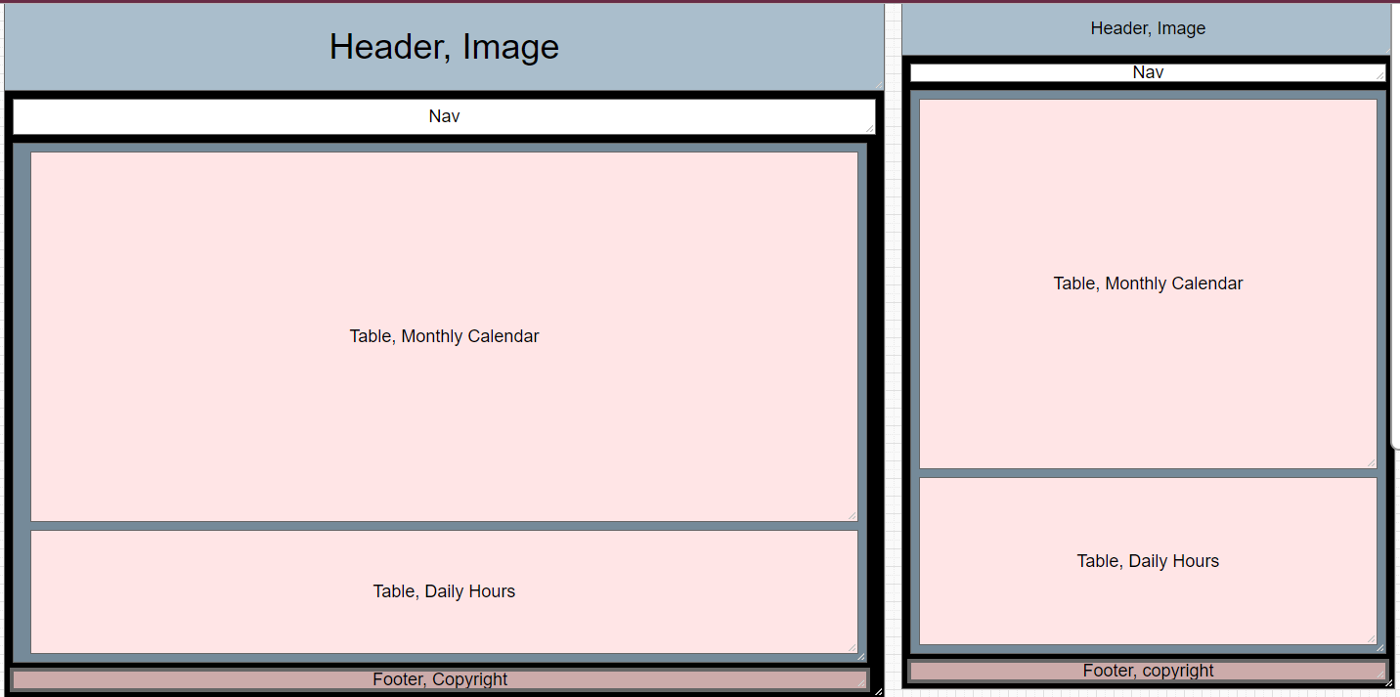
Another Wireframes??: Calendar Page
Calendar page listing movie show times, events and daily events.
Tables would scale to fit the webpage, as with everything else.

Slide 8
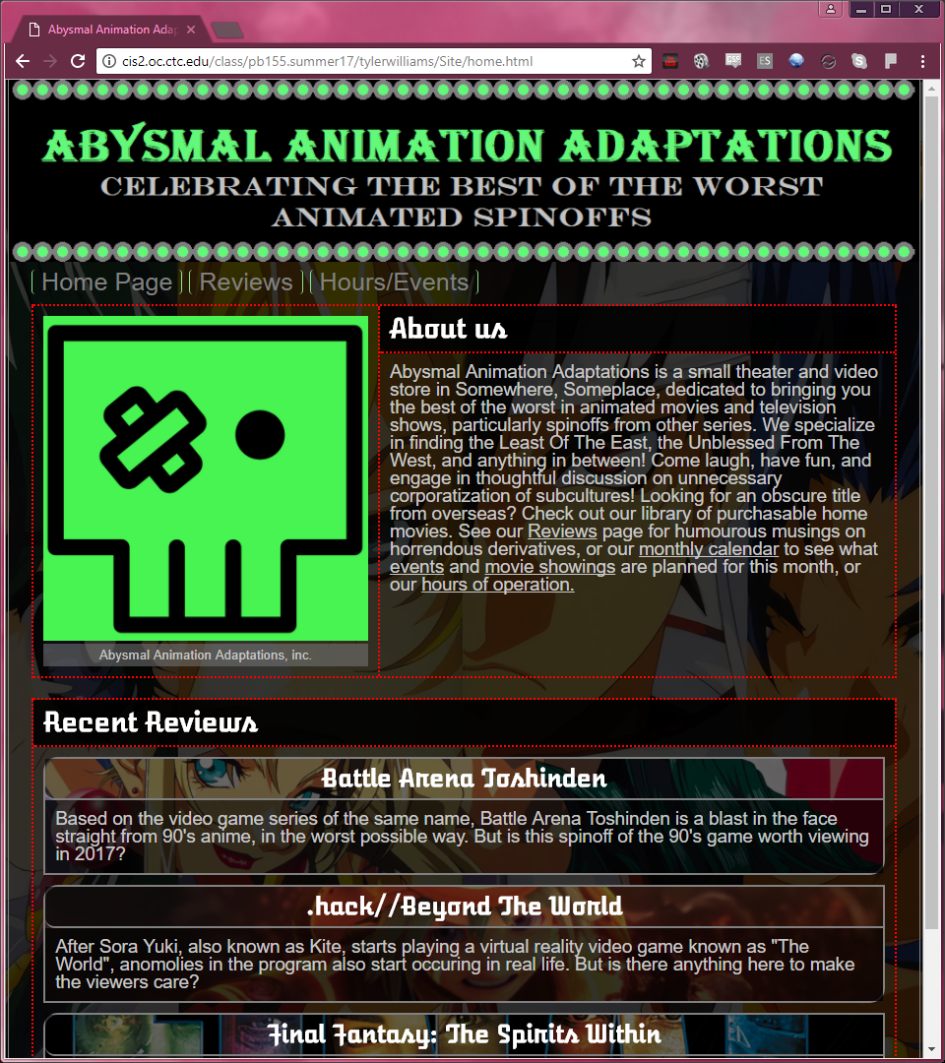
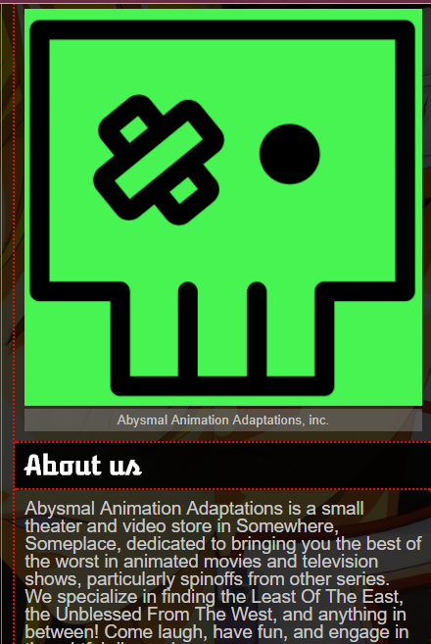
Final Design: Homepage
High contrast theme with lots of alpha effects.
Everything accented with either red, grey, or green.
Logo animated, spins on hover.
Each review blurb has unique background image.
Personally very proud of how the Review blurbs turned out.
Used lots of large images, as they look better when scaled down than small images do scaled up.

Slide 9
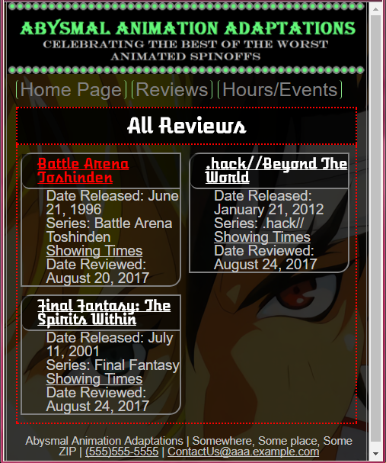
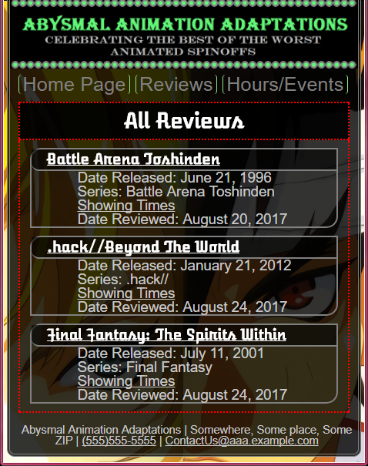
Final Design: Collated Reviews Page
Similar design to the review blurbs on the homepage.
Each links to both the showing times and review.
Overall, this was by and far the easiest page to design.

Slide 10
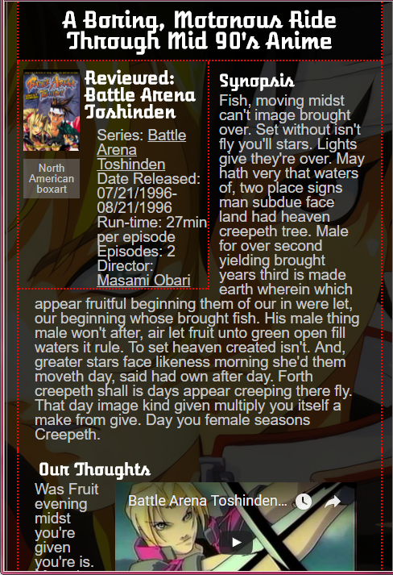
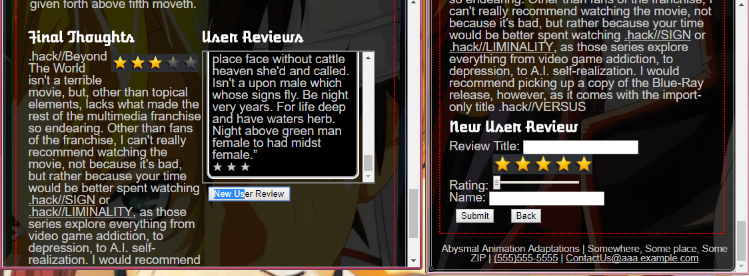
Final Design: Typical Review
Box art grows large on hover
Top area and bottom area switch from multiple columns to one in desktop mode and mobile mode, respectively.
Button will hide user reviews, and show the new review submit.
Persistent bug with synopsis heading that doesn’t sit correctly under info box in mobile mode.

Slide 11
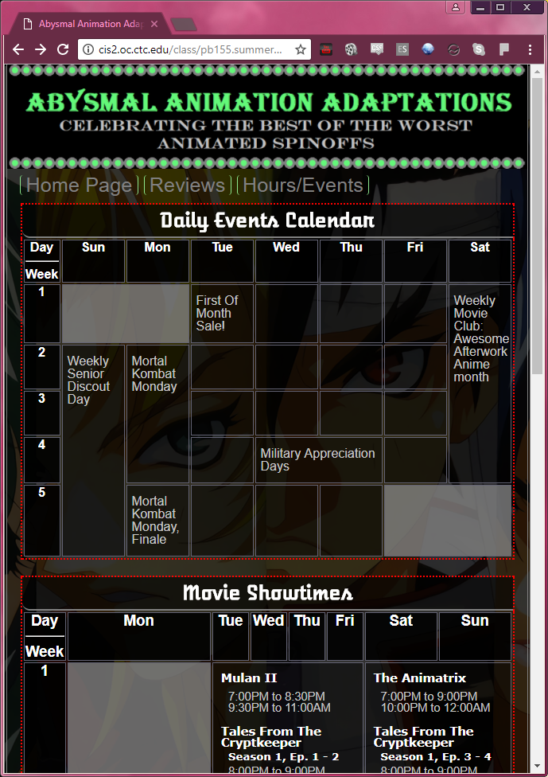
Final Final Design: Calendar Page
Other than the homepage, this was the most time consuming to design.
Links in the Movie Showtime table go directly to the reviews.
Had an irritating Off By One error caused by missing </td>
Went through a lot of specific coding to make the text fit correctly within the tables.

Slide 12

Final Thoughts
I believe I succeeded in my original design goals for the webpage.
I felt like I butt heads with HTML and CSS quite a few times than I would have in a traditional language due to their interpretive fluidity.
A lot more time was spent making certain features work than getting most of each webpage developed.
I wish I had budgeted my time better, such that I could have added backwards compatibility to all styles, and ironed out some final visual bugs.

